Slide 1
Classification or Decision Tree
CART
Classification And Regression Tree

Slide 2
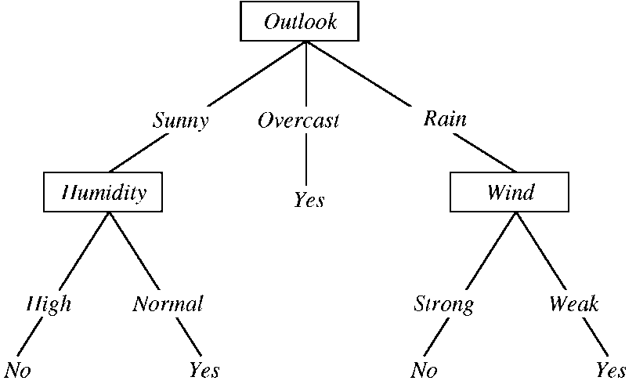
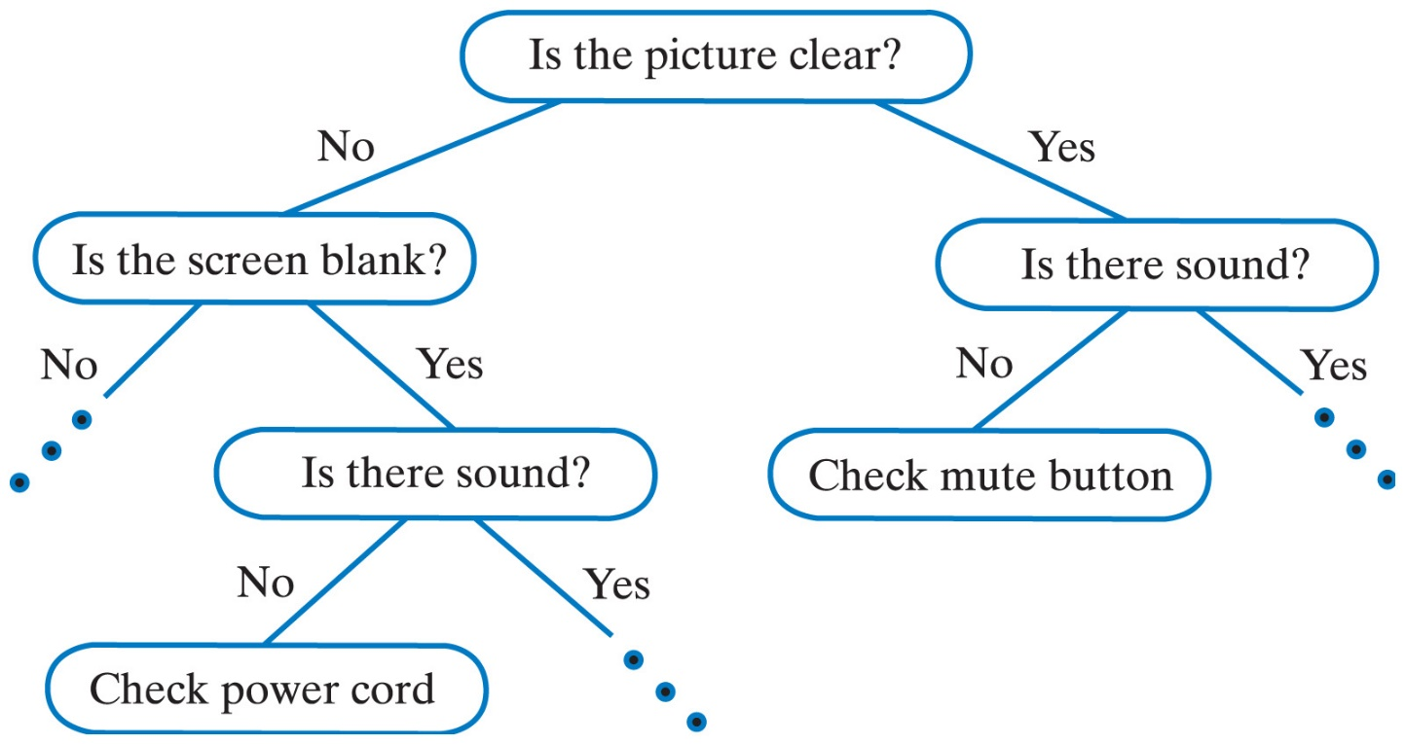
Decision Tree - Classification

Slide 3
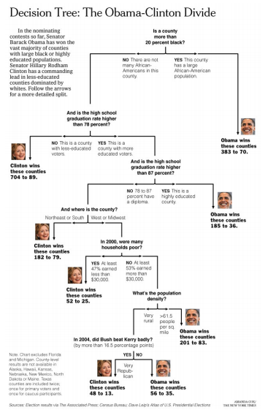

Slide 4
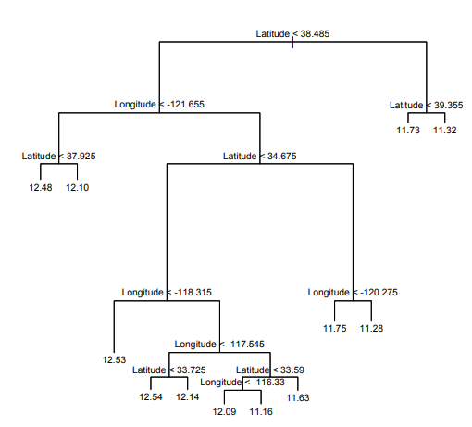
Regression Decision Tree
Median House Prices in California based on Latitude and Longitude
Source: Classification and Regression Trees, Data Mining

Slide 5
Decision Trees
Supervised Machine Learning algorithm
Mainly used for classification
Works for both categorical and continuous output variables
Terminology:
  Root Node: Represents entire population
  Decision Node: Node that is split into sub-nodes
  Splitting: Dividing Decision node into sub-nodes
  Leaf/Terminal Node: Nodes that can no longer split
  Pruning: Removing sub-nodes of a decision node
  Branch: Sub-section of entire tree
  Parent and Child node

Slide 6
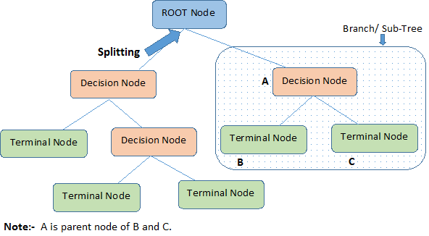
Decision Tree Terminology

Slide 7
Decision Trees
Advantages
  Easy to interpret
  Automated field selection
  No data processing required
    Variable transformation not required
    Can handle outliers
    Missing value tolerant
Disadvantages
  Not ideal for prediction of continuous attribute
  Cannot handle large amounts of data
  Recommend less than 16 leaf nodes

Slide 8
Decision Tree – Model Design
    Data should have both 0 (Bad) and 1 (Good) data
    Remove indeterminate values (NAs)
    Look for categorical variables
    Look for meaningful trend. Eg: Height should increase with Age.
    Look for default values like -999. Convert them to missing values. Maybe remove it.
    Look for capping/floor values – Age > 100
    Reasons to create meaningful group – Group all small Northeastern states

Slide 9
Decisions for Decision Models
Which variable to split first? (Root Node)
What is the splitting criteria?
How to choose the splitting criteria?
How many splits? (Binary/Multi split)
How deep to grow the tree?

Slide 10
Classification Techniques
Classification and Regression Tree (CART):
  Binary Decision Tree
  Classification (Categorical output variable)
  Regression (Continuous output variable)
  Uses Gini Index
CHAID – CHI-squared Automatic Interaction Detector:
  Non-Binary Decision Tree
  Use statistical significance of proportions

Slide 11
Splitting Criteria
Homogeneity/Purity based on classes
Table is PURE if it contains only a single class
Table is Impure if it contains equal proportion of all classes
Measures of Impurity
  Gini Index
  Entropy
  Classification Error

Slide 12
CART MODEL
Let us Build a Decision Tree!!!

Slide 13

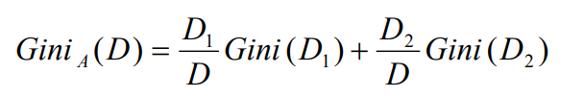

Gini Index Calculations
m : Number of Classes
p : Probability that a record in D belongs to class Ci
Gini Index consists of binary split (D₁ and D₂) for each attribute A
Reduction in Impurity is given by:
The attribute that Maximizes the reduction in impurity is chosen as the Splitting Attribute

Slide 14
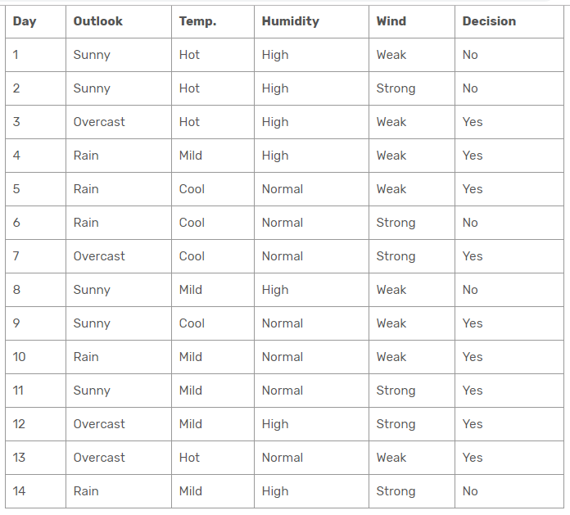
Gini Index Calculations

Slide 15
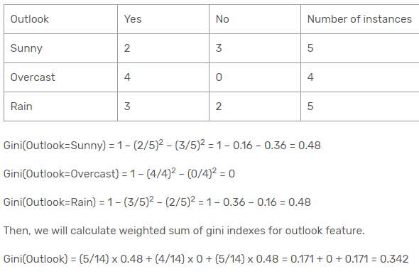
Gini Calculations - Outlook
Source: https://sefiks.com/2018/08/27/a-step-by-step-cart-decision-tree-example/

Slide 16
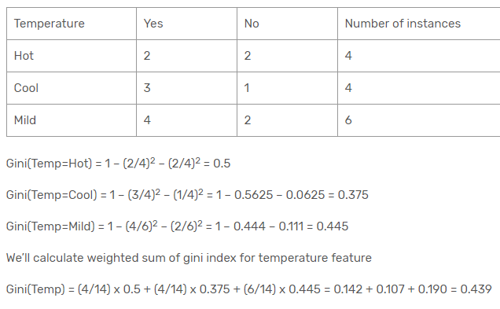
Gini Calculations - Temperature

Slide 17
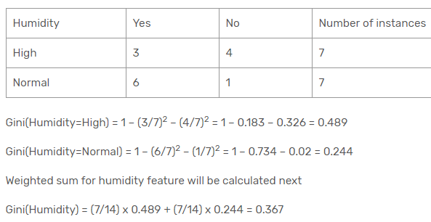
Gini Calculations - Humidity

Slide 18
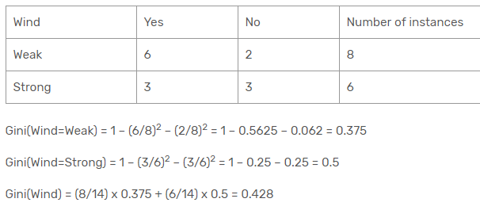
Gini Calculations - Wind

Slide 19
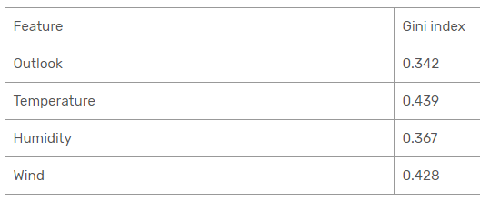
Gini Calculations
Lowest Gini Index

Slide 20
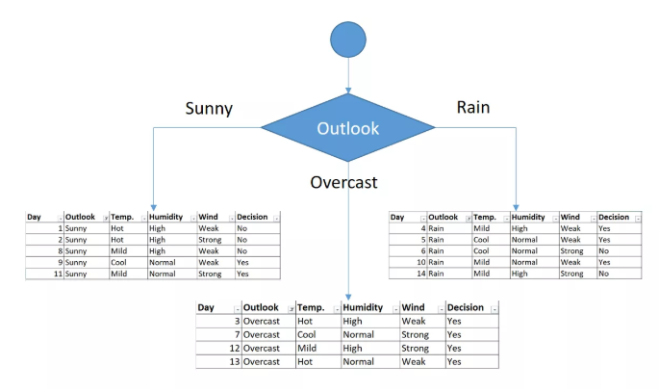
Gini Calculations
All ‘Yes’

Slide 21
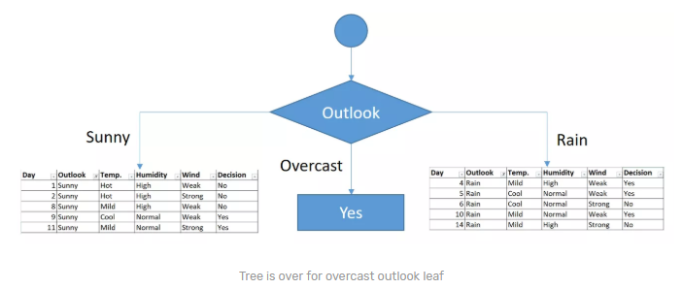
Gini Calculations

Slide 22
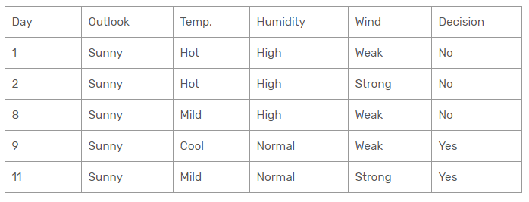
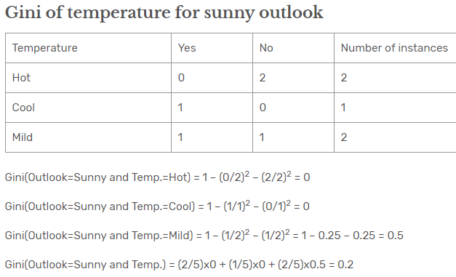
Gini Calculations

Slide 23
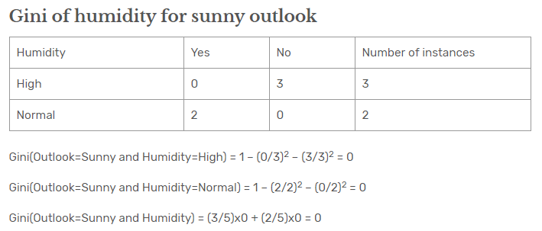
Gini Calculations

Slide 24
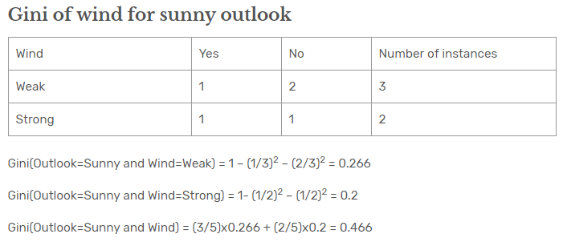
Gini Calculations

Slide 25
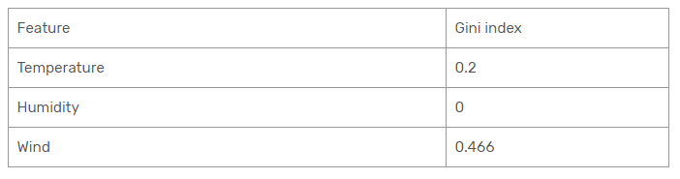
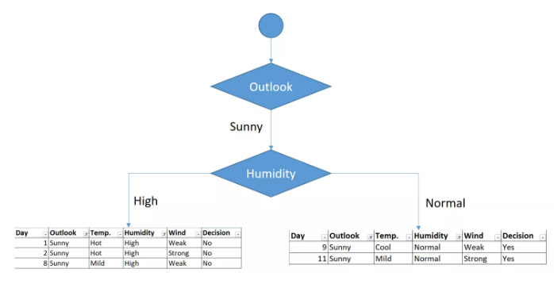
Gini Calculations
Lowest Gini
Humidity Branch is now over!!

Slide 26
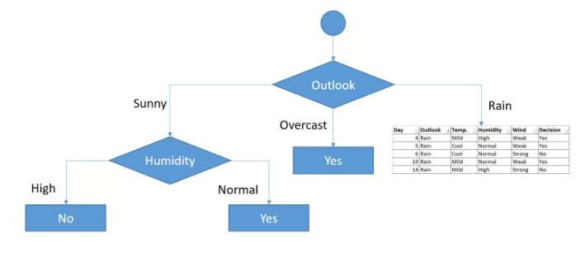
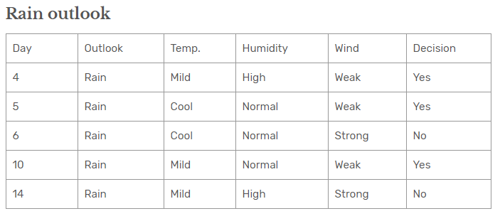
Gini Calculations

Slide 27
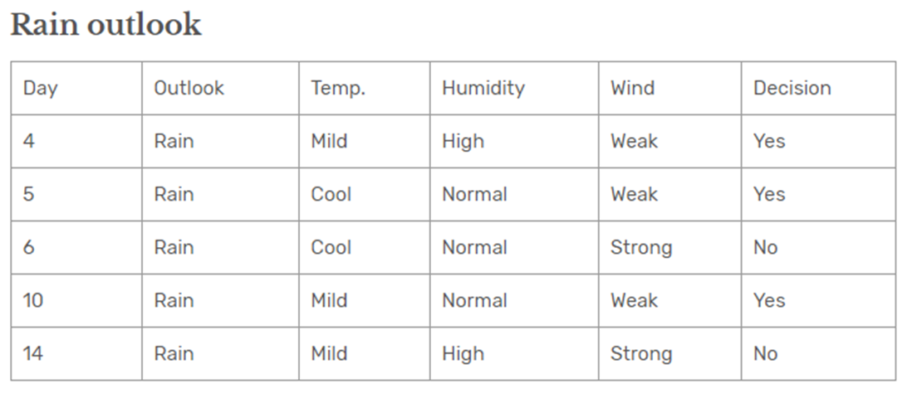
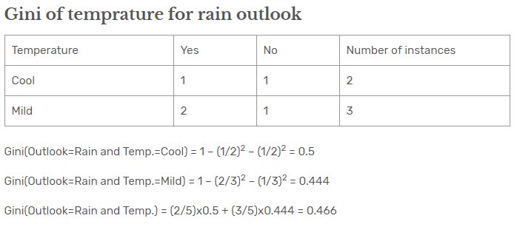
Gini Calculations

Slide 28
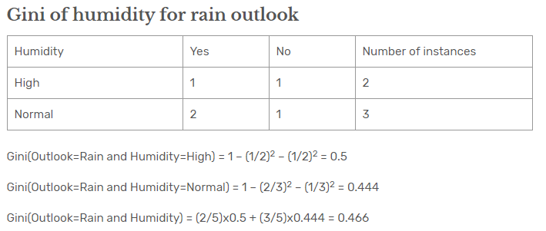
Gini Calculations

Slide 29
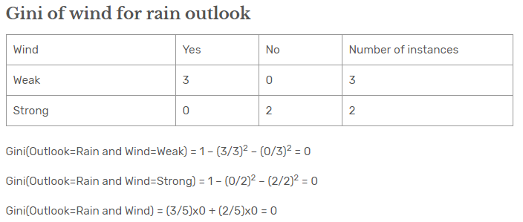
Gini Calculations

Slide 30
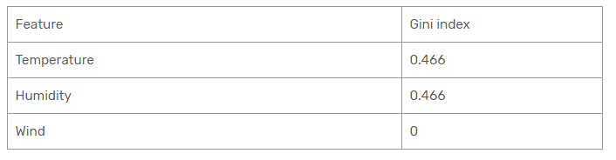
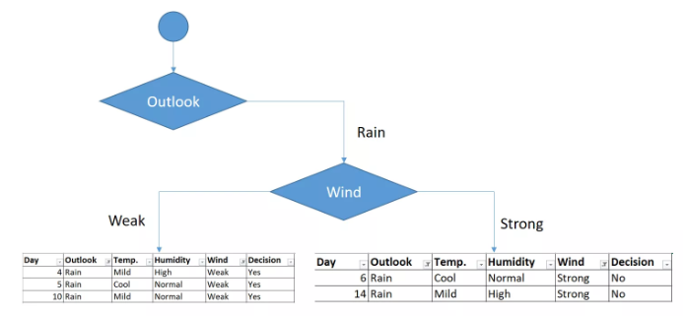
Gini Calculations

Slide 31
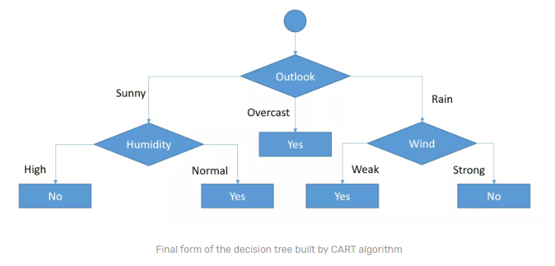
Gini Calculations

Slide 32
Resubstitution Error and Complexity Parameter (cp)
Resubstitution Error: Fraction of cases incorrectly classified when we assign majority class to a node
This favours a large tree
Complexity Parameter (cp):
Measure of Avg. Error reduced per leaf
  Counter-balance to Resubstitution Error
  Applies cost for adding more nodes
  Measures average error reduced per leaf
  Compares to cost adding a new leaf
  Favours a smaller tree

Slide 33
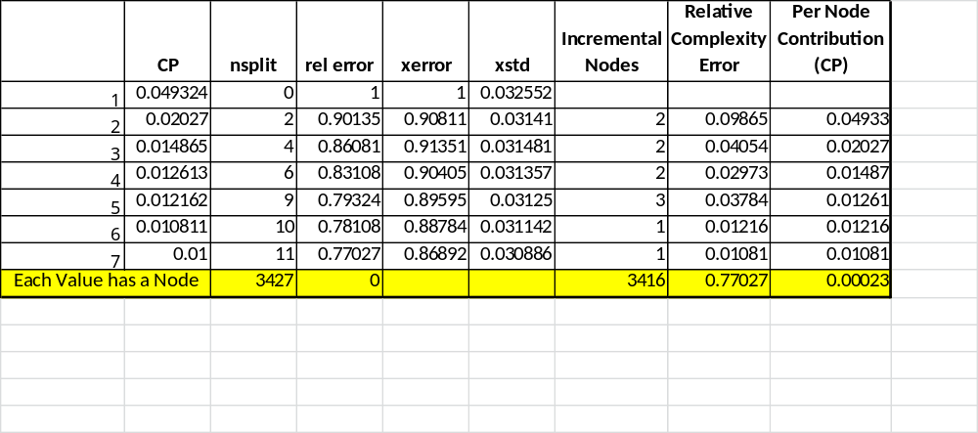

Cp Calculations

Slide 34
Limitations of Decision Trees
Vulnerable to over-fitting
Greedy Algorithm
Resource Intensive

Slide 35
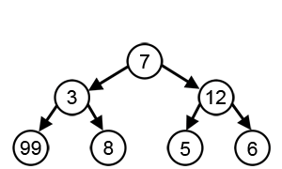
Greedy Algorithm
Makes a choice that is best at the moment
Does not reverse its decision
Could result in non-optimal solutions
Selecting the node with highest Gini-Index could result in Sub-Optimal Solution

Slide 36
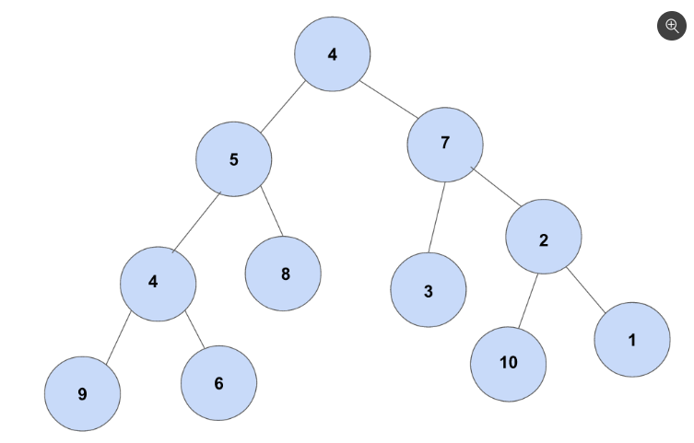
Greedy Algorithm Exercise
Greedy Path: 4 + 7 + 3 = 14
Optimal Path: 4 + 7 + 2 + 10 = 23
Source: https://brilliant.org/problems/greedy-algorithm/

Slide 37
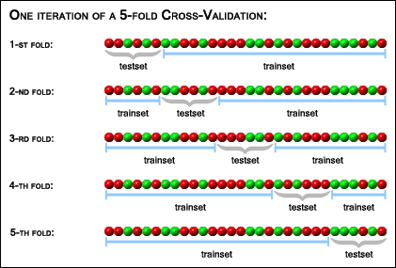
Cross Validation
Source: https://stats.stackexchange.com/questions/1826/cross-validation-in-plain-english

Slide 38
Cross-Validation
Helps overcome Greedy Algorithm problem
Part of CART algorithm
How good is the model with unseen data?
Also helps address ‘Over Fitting’

Slide 39
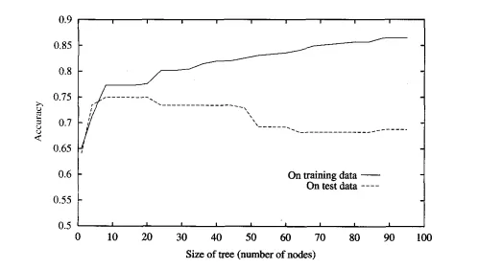
Over Fitting
Works extremely well on Training dataset
Performs poorly on unseen dataset

Slide 40
How to Avoid Over Fitting?
Pre-pruning:
  Stopping Rule:
  Stop growing the tree if impurity reduction is below a certain threshold
Post-pruning:
Fully grow the tree and merge-back using Error-Estimation or Chi-Square Test

Slide 41
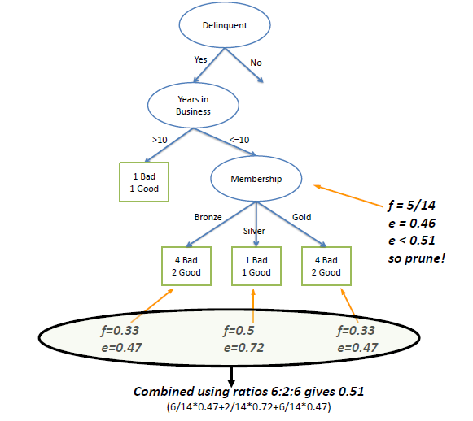
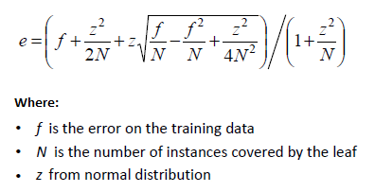
How to Avoid Over Fitting
Error increased from 0.46 to 0.51
Therefore, Prune Child Level for Membership

Slide 42












Overall flow of the CART classification process
Feature engineering
– convert relevant variables to categorical
EDA – Univariate
Boxplot for num var
Barplot for cat var
Find Baseline Y class
% to check class imbalance
Read csv file
EDA – bivariate
Boxplot – num X vs cat Y
Stacked bar – cat X vs Y
Split into training and test sets
Build a fully grown tree
Predict on train & test set
Prune tree & predict
Stopping criteria –
minbucket, minsplit
Cp
Model performance
Acc, sens, spec
AUC
Check for over fitting
Variable importance

